Slide 1
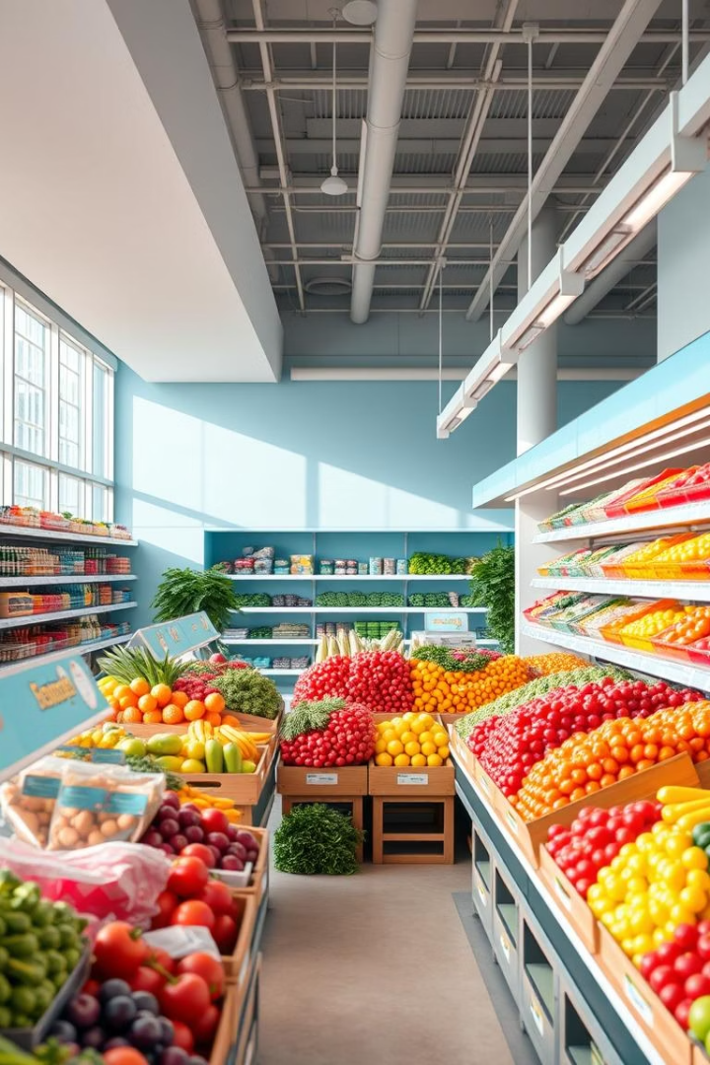
Grocery Management System
Group Members:
1. Revatee Ghatage 102
2. Sanaa Shaikh 103
3. Anisha Shiudkar 119
4. Sakshi Sambhaji 125

Slide 2

Introduction
Purpose
Scope
Significance
To manage grocery items efficiently with features like adding , editing, removing and billing.
Java Swing-based desktop app for small shops or personal use ,with real-time updates and search functionality.
Improve accuracy ,saves time ,and streamlines daily grocery management tasks.

Slide 3

Objectives
1
To create simple and effective grocery billing system.
2
Calculate and display total cost dynamically.
3
Provide functionalities to manage item records.
4
Enable quick search of items from the list.

Slide 4





System Architecture
User Interface
Logic Layer
Data Management
Output
JFrame , JTable ,JTextField ,
JButton ,JLabel , JPanel
User Inputs
Calculations
Table Operations
Event Handling
Default TableModel
Tabular Data
Total Billing Display.

Slide 5

Working of the System
User enters item name ,
Quantity and price.
Clicking Add adds the
item to the table and
updates the total.
Edit allows updating
Selected item details.
Remove deleted selected
row from the table.
Clear All deletes all entries.
Search highlights the item if found in the table.
Total Bill is updated after every operation.

Slide 6
Java Concepts Used
Swing Framework
Event Handling
Exception Handling
OOP Concepts
GUI design using JFrame JPanel ,JButton ,JTable ,etc.
ActionListener for button action.
Handles invalid inputs with try-catch.
Encapsulation via private fields and methods.

